Slide 1
C021TV-I1-S3

Slide 2
ICN : 1. Binary coding
1. Data representation in the form of bits
2. Storing images or sounds
3. Compression
4. Data organisation
5. Database
Notes:
Introduction de la semaine 2/2
Présentation du sommaire global de la semaine : apparition progressive des éléments de la liste, puis mise en évidence de la portion concernée par la vidéo.
Mise en évidence = police noire + gras

Slide 3
Why compress?
Imagine a 2-hour Full HD film (without sound)
7200 seconds x 24 images per second = 172 800 images
1920x1080 pixels = 2 073 600 pixels per image
24 bits for every pixel’s coulours
8 599 633 920 000 bits needed to store the video
That’s 1 Térabyte!
Download for 100 hours with an ADSL connexion
Not great for Video On Demand…
How do you store that film on a DVD allowing a few gigabytes?

Slide 4
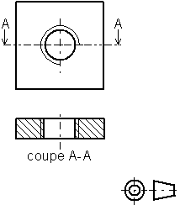
Images compression
Some images contain redunding areas
Similar colours, similar areas…
No need to store the same data several times
Allows to reduce significantly
the size of « simple images »
Image format GIF, PNG, …
The same techniques can be applied for text,
sounds, etc…

Slide 5
Photos compression
Photos are often non-redundant
Do we need every detail?
Can the human eye distinguish two similar pixels?
Image format JPEG, …
More or less satisfying results
depending on the compression rate
Compression with loss
by pixel blocks approximation

Slide 6
Videos compression
In a film, successive images are often very similar
Store a complete image from time to time
At the beginning of each shot
Then only store the differences
Format MPEG, …
Find the similarities across the images
and only store the differences

Slide 7
Sound compression
The human ear only perceives frequencies between 20 Hz and 20 kHz
No need to code other sound frequencies
Similar frequencies can be approximated
MP3 format
Once coded, the signal can be listened to again, or processed to apply effects (reverb, …)

Slide 8
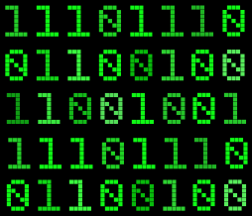
To sum it up
Various ways to (de)code or extract/compress multimedia data
More or less fitting according to the situation
The computer does not understand what it handles
Meaningless rows of bits
Data contain a heading explaining how it is coded (size, duration, colours, compression, …)

