Slide 1
C021TV-I4-S1

Slide 2
ICN : 4. Computer architecture and networks
1. Elementary components of computer
2. Execution principles of a program
3. Information transmission principles
4. Network structuring
Notes:
Introduction de la semaine 2/2
Présentation du sommaire global de la semaine : apparition progressive des éléments de la liste, puis mise en évidence de la portion concernée par la vidéo.
Mise en évidence = police noire + gras

Slide 3
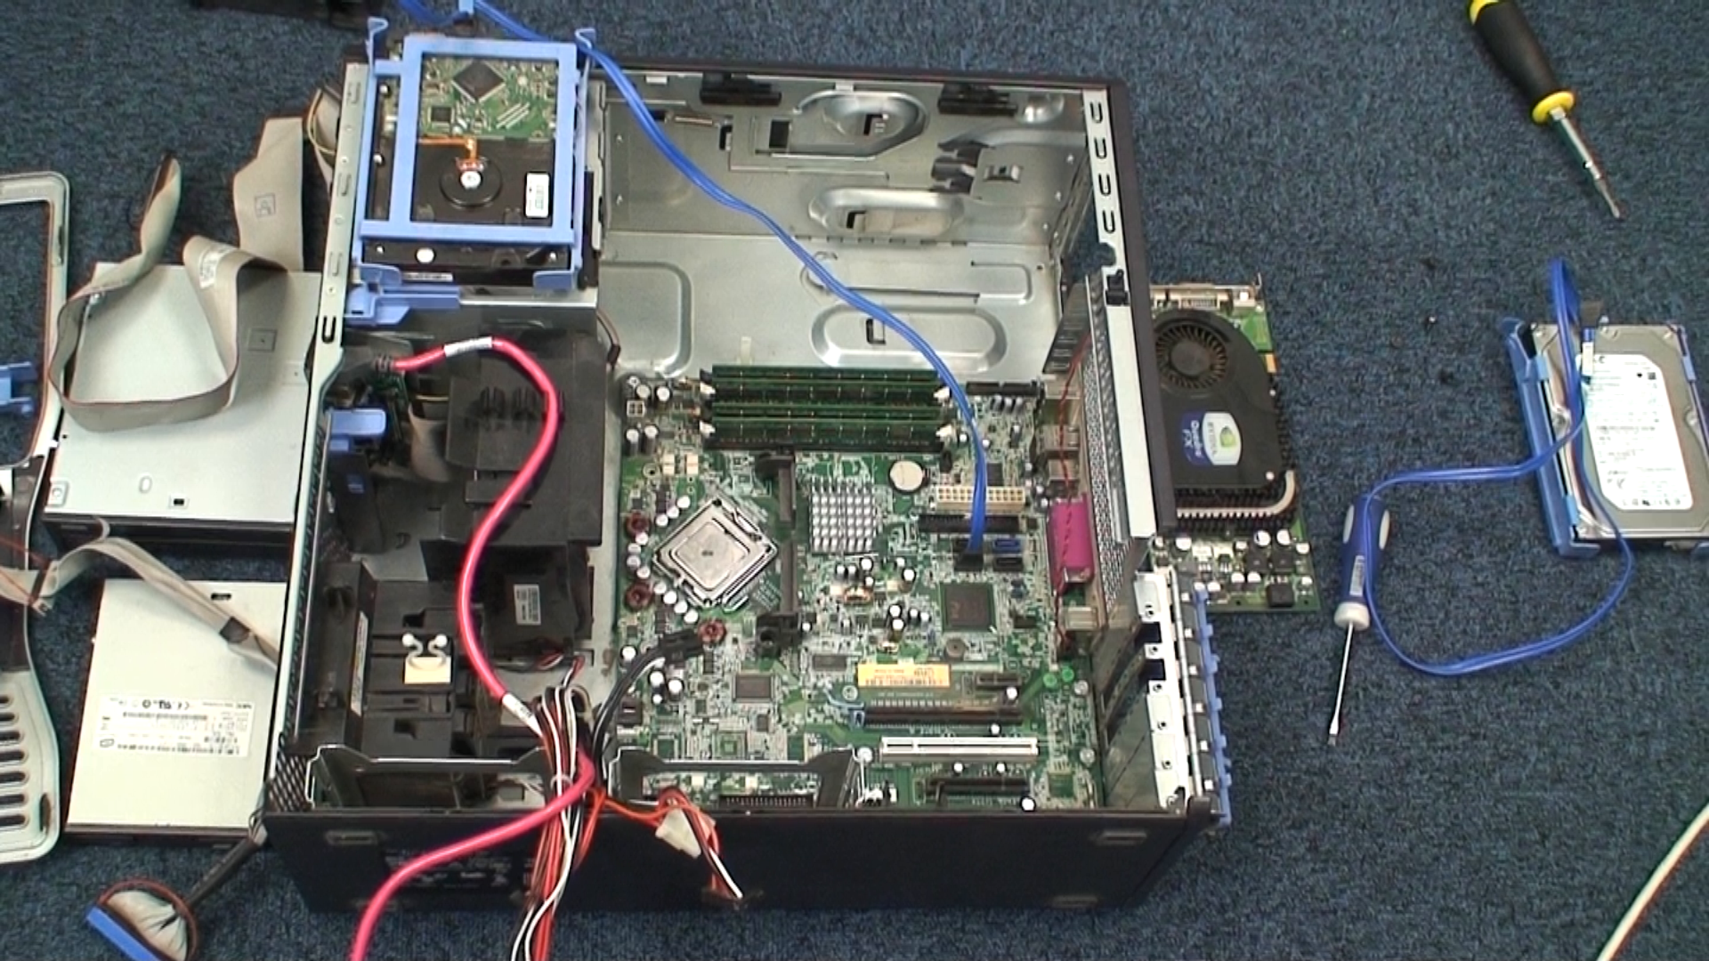
Processor

Slide 4
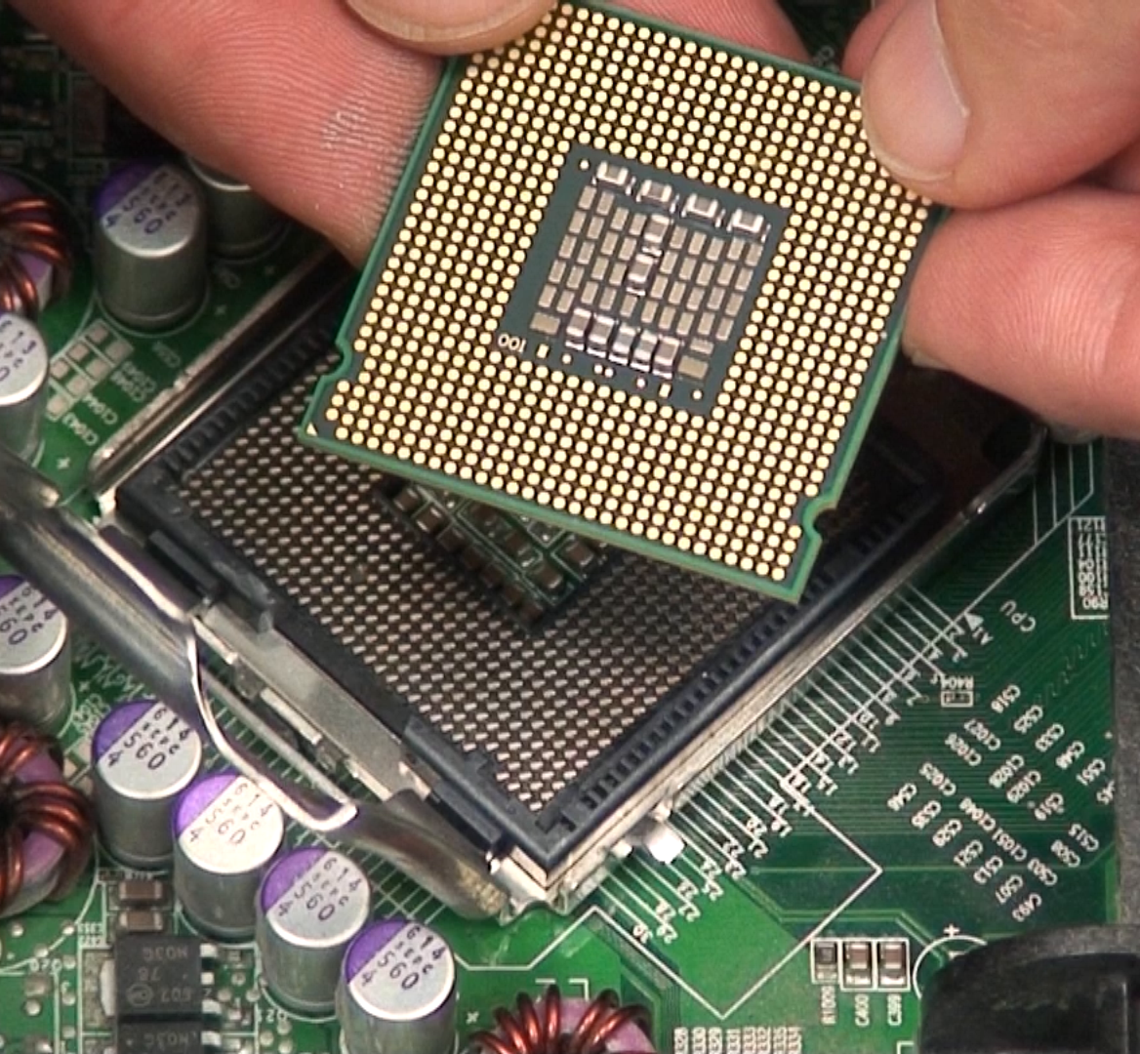
Processing is done by the processor
It is the heart of the computer, the smartphone, of the connected TV, …
Data reading and writing
Operations on bits
Addition, multiplication, comparisons, …
Several billion operations per second
But simple operations, no intelligence
All calculations are done by the processor
Notes:
Donc ca chauffe

Slide 5
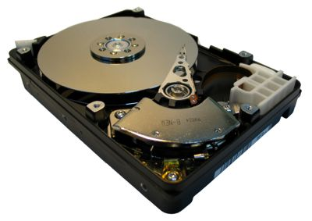
Data handled by the processor
The processor uses input data and generates output data
2 + 3 = 5
Where to store this data?
Most of the time on the hard drive
Images to display, text file to modifiy, program to launch, …
In the end, the result often gets back to the hard drive
Modified image, completed text file, …
Lots of data exchanges between the processor and the hard drive

Slide 6
Processor
Disks

Slide 7
What does RAM do?
The hard drive is very slow
The processor performs an operation
every nanosecond approximately
The hard drive is much slower
The RAM memory is a mediator
Only the original and final data are stored on the hard drive
Temporary results stay in the memory
RAM is smaller, but much faster

Slide 8
Memory
Data exchanges
Processor
Disk

Slide 9
How to communicate with the outside?
Interact with the user?
Communicate with other computers?
Peripherals are connected to the processor and the memory
Screen, printer, virtual reality headgear, … for the output
Mouse, keyboard, joystick, touchscreen, camera, sensors, … for the input
Wired network card, wifi, antenna for communications, …
The processor writes and/or reads on those peripherals

Slide 10
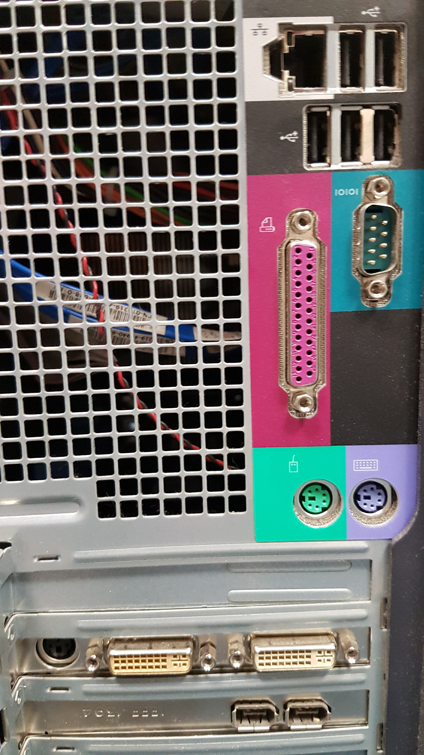
USB
Network
(RJ45)
Keyboard and mouse
(old models)
Parallel and serial ports (obsolete)
Video output

Slide 11
A smartphone is a computer with a lot of integrated peripherals
Camera
Loud speaker
Proximity sensor
Touchscreen
And also Gyroscope, Accelerometer,
Microphone, Antennas, Vibrator, etc.
Reduced keyboard

Slide 12
To summarize
The processor does the processings.
By using data stored on the memory.
This data can come from the hard drive or one of the many input peripherals.
The resulting data can be stored on the hard drive or go through one of the many output peripherals.

